Slide 1
Classification Models: Predicting Employee Churn
Team 1
(Shaurya and Jay)

Slide 2
Introduction: About the dataset
Data from independent Glassdoor survey
Picked from Kaggle
~ 67k observations and 19 variables.
Major variables:
1) Overall ratings 2) Cultural value 3) Senior Management
4) Work life balance 5) Career Opportunity 6) Compensation Benefits
7) Organizations (Amazon, Apple, Facebook, Google, Microsoft, Netflix)
8) Month 9) Year 10) Date 11)Pros 12) Cons
Notes:
Glassdoor is a website where current and former employees anonymously review companies and their management.
Another variable like feedback to management

Slide 3
Objectives and Project Goals
To build a model (or models) that predict whether or not an employee is likely to leave his/her job based on survey filled at Glassdoor.
Higher the probability of the predicted Employee being a Current Employee, less the chances for him/her to leave the organization.

Slide 4
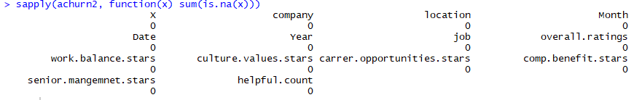
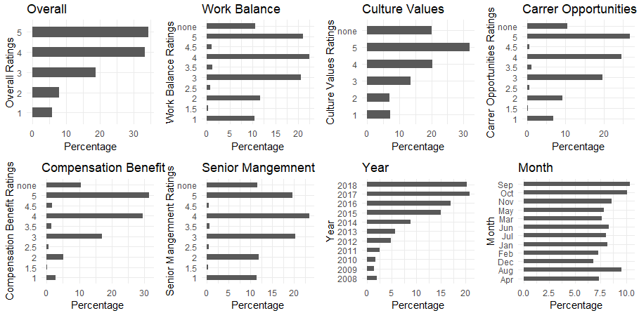
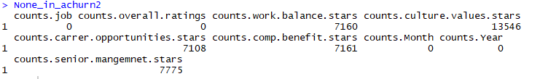
Exploratory Data Analysis
No NA/Null Values
Discovered None Values
None values count

Slide 5
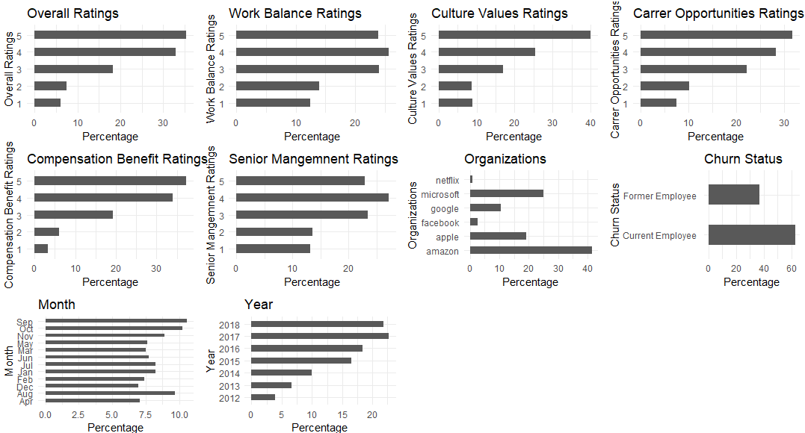
Exploratory Data Analysis
Observation with none dropped, As all the ratings are individually filled by the employees and there is no dependency of calculating a missing value.
~ 53k remained
Notes:
Around 20 % of the data lost

Slide 6
Initial Model: With all variables without any sequence. Most Significant Company > overall ratings > Year > senior mgmt. stars > work balance stars > culture values stars > Month > comp ben stars > Career opp stars Least Significant Multiple models with Anova with most significant to least significant added one at a time.
Logistic Regression
Variables in Model | Model Residual Deviance
None | 55265
Company | 54827
Company + overall rating | 53512
Company + overall rating + Year | 53342
Company + overall rating + Year + Senior management stars | 53210
Company+ overall rating+ Year + Senior management stars + Work balance stars | 53169
Company+ overall rating+ Year + Senior management stars + Work balance stars + cultural value stars | 53143
Company+ overall rating+ Year + Senior management stars + Work balance stars + cultural value stars + Month | 53133
Company+ overall rating+ Year + Senior management stars + Work balance stars + cultural value stars + Month + comp benefit stars | 53085
Company+ overall rating+ Year + Senior management stars + Work balance stars + cultural value stars + Month + comp benefit stars + carrer opp stars | 53025

Slide 7
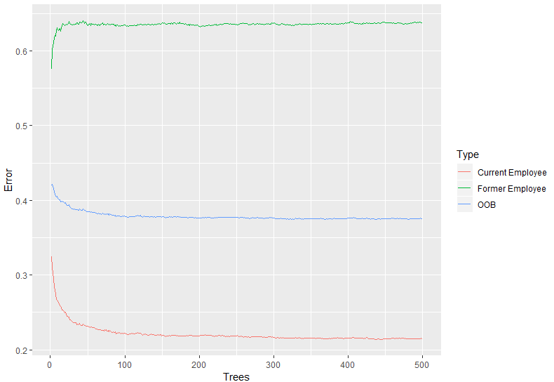
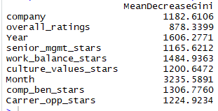
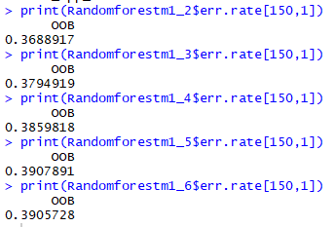
Random Forest
1) Optimizing Trees
2) Optimizing Features
3) Optimizing Splits
Notes:
Selected variables: Year, Work life balance, Month, Compensation stars, Career Opportunities
The mean decrease in Gini coefficient is a measure of how each variable contributes to the homogeneity of the nodes and leaves in the resulting random forest.

Slide 8
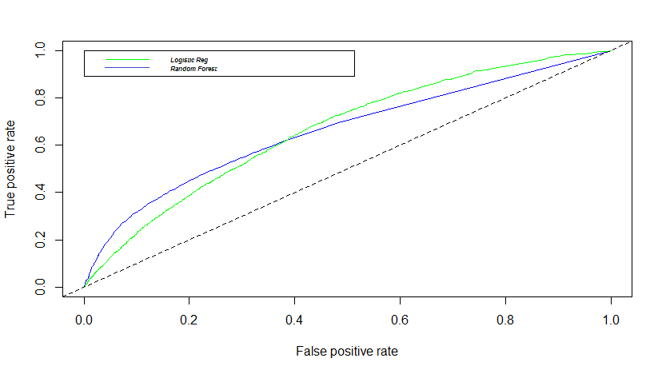
Model Performance
Performance Metrics
Receiver Operating Characteristic
Model | Logistic Regression |  | Random Forest
Metrics/ Data | Training Data | Test Data | Training Data | Test Data
Error Rate | 0.460 | 0.350 | 0.390 | 0.340
Accuracy | 0.543 | 0.665 | 0.610 | 0.660
Sensitivity | 0.840 | 0.977 | 0.880 | 0.940
Specificity | 0.059 | 0.004 | 0.170 | 0.120
Model | Logistic Regression | Random Forest
Area under the Curve | 0.665 | 0.661
Notes:
Accuracy is at default threshold of .5
AUC is accuracy computed by adding all the accuracies for all the possible threshold values. It like average of accuracies at possible threshold.
How much the AUC tells is that how much model is capable of distinguishing between classes. The higher the AUC better the model in predicting current and former employees.
Error rate LR .11 RF .05 Acc LR .12 RF .05 Sensitivity LR .137 RF .06 Spe LR .055 Fr .05

Slide 9
Conclusion
Using Random Forest is a more efficient way to handle increasing number of variables. The tuning parameters used to build the model also creates a more stable model that has a small difference in prediction from Training and Test Data. Logistic Regression is more manual in terms of tuning and understanding the variables.
Next Steps
For the next phase we want to further drill down into the pros and cons column, scrape negative and positive words that can predict whether the employee stay or not. We can do this by taking in inventory of the positive and negative words and create new variables for these word counts which can further contribute to the response variable to provide better prediction

